Slide 1
Configuring NAT
Notes:
11.2 Configuring NAT

Slide 2
Configuring Static NAT Configuring Static NAT
There are two basic tasks to perform when configuring static NAT translations:
Create the mapping between the inside local and outside local addresses.
Define which interfaces belong to the inside network and which belong to the outside network.
Notes:
11.2.1.1 Configuring Static NAT

Slide 3
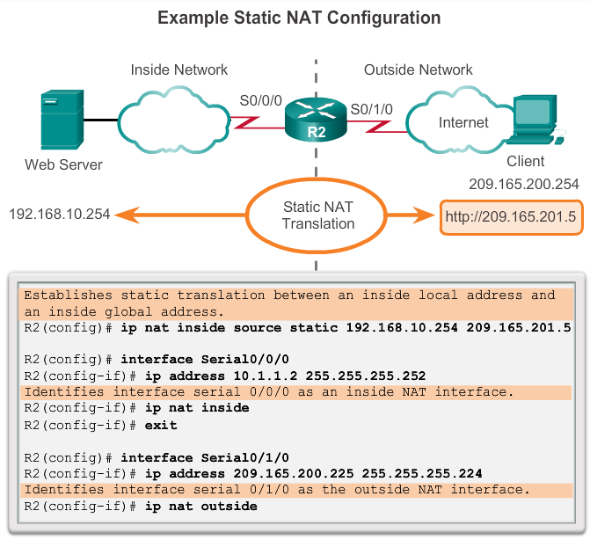
Configuring Static NAT Configuring Static NAT
Notes:
11.2.1.1 Configuring Static NAT

Slide 4
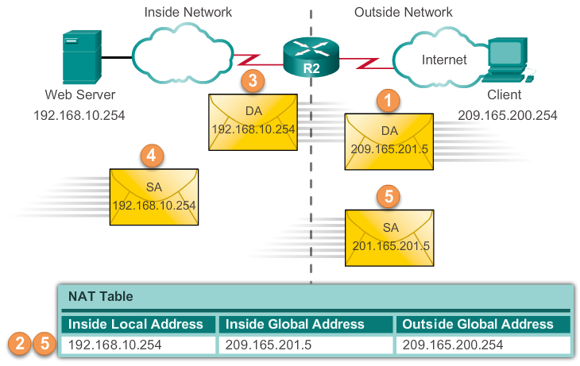
Configuring Static NAT Analyzing Static NAT
Notes:
11.2.1.2 Analyzing Static NAT

Slide 5
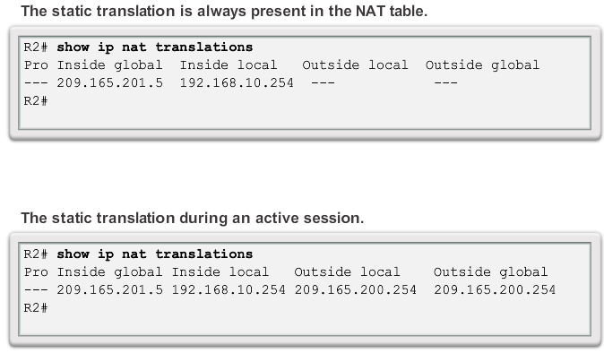
Configuring Static NAT Verifying Static NAT
Notes:
11.2.1.2 Verifying Static NAT

Slide 6
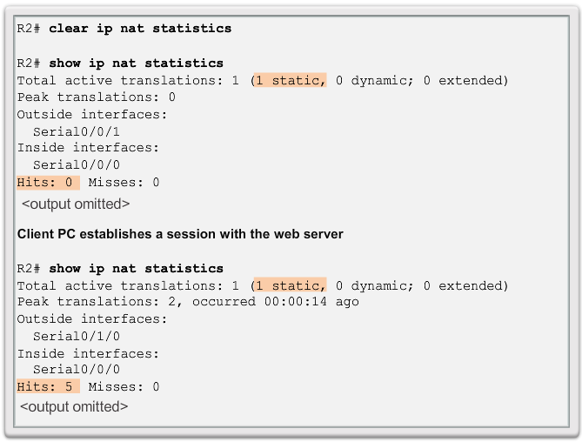
Configuring Static NAT Verifying Static NAT (cont.)
Notes:
11.2.1.2 Verifying Static NAT

Slide 7
Configuring Dynamic NAT Dynamic NAT Operation
The pool of public IPv4 addresses (inside global address pool) is available to any device on the inside network on a first-come, first-served basis.
With dynamic NAT, a single inside address is translated to a single outside address.
The pool must be large enough to accommodate all inside devices.
A device is unable to communicate to any external networks if no addresses are available in the pool.
Notes:
11.2.2.1 Dynamic NAT Operation

Slide 8
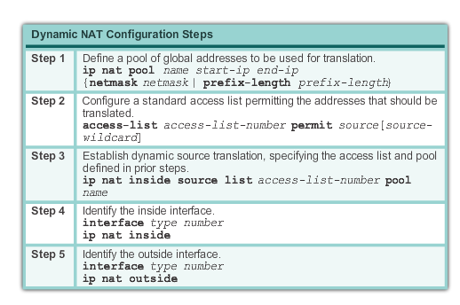
Configuring Dynamic NAT Configuring Dynamic NAT
Notes:
11.2.2.2 Configuring Dynamic NAT

Slide 9
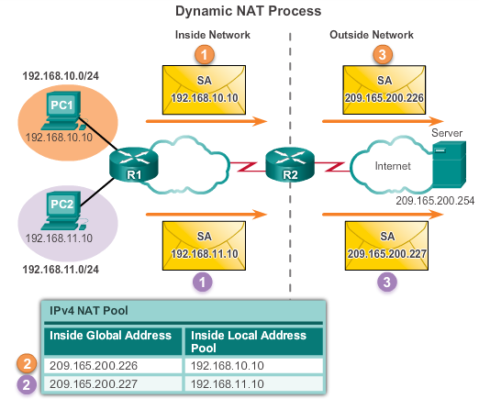
Configuring Dynamic NAT Analyzing Dynamic NAT
Notes:
11.2.2.3 Analyzing Dynamic NAT

Slide 10
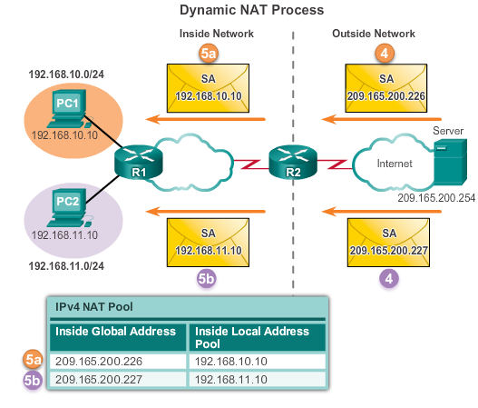
Configuring Dynamic NAT Analyzing Dynamic NAT
Notes:
11.2.2.3 Analyzing Dynamic NAT

Slide 11
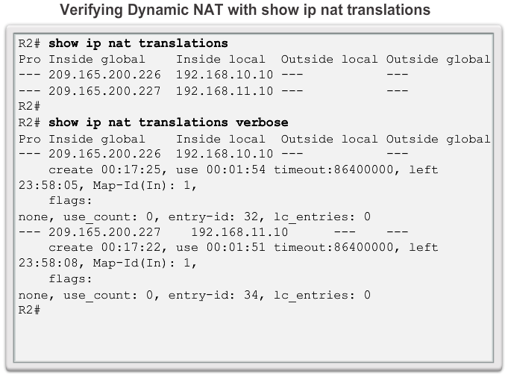
Configuring Dynamic NAT Verifying Dynamic NAT
Notes:
11.2.2.4 Verifying Dynamic NAT

Slide 12
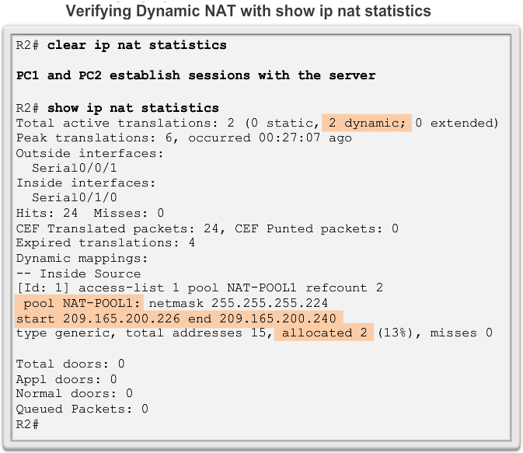
Configuring Dynamic NAT Verifying Dynamic NAT
Notes:
11.2.2.4 Verifying Dynamic NAT

Slide 13
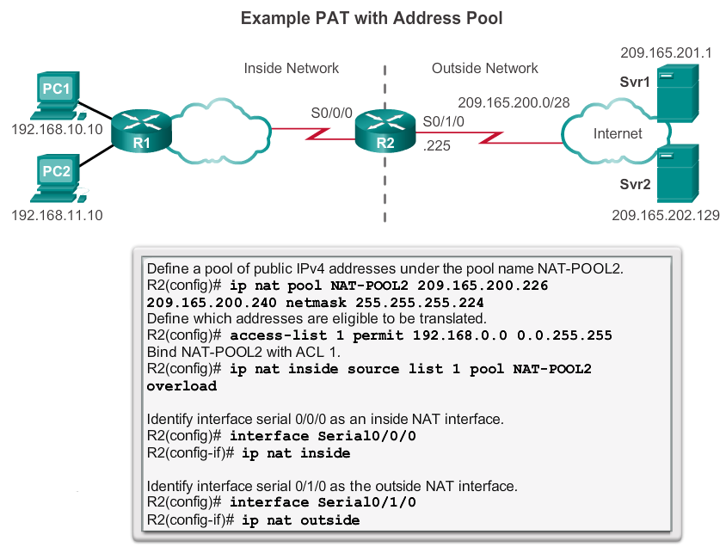
Configuring PAT Configuring PAT: Address Pool
Notes:
11.2.3.1 Configuring PAT: Address Pool

Slide 14
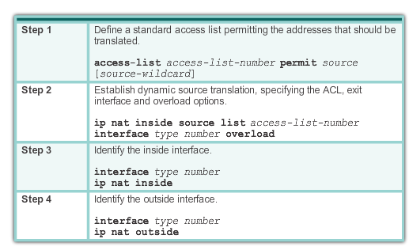
Configuring PAT Configuring PAT: Single Address
Notes:
11.2.3.2 Configuring PAT: Single Address

Slide 15
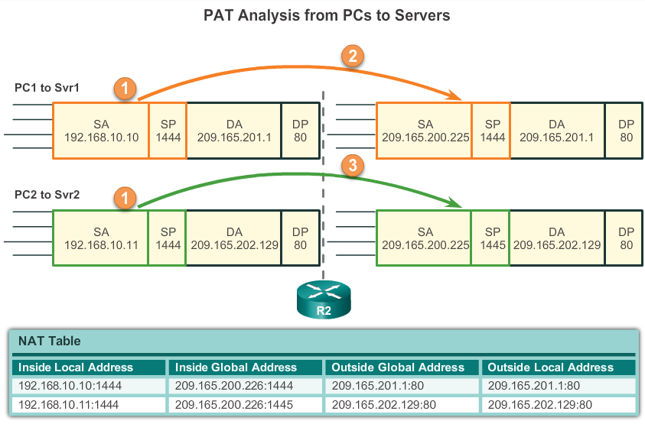
Configuring PAT Analyzing PAT
Notes:
11.2.3.3 Analyzing PAT

Slide 16
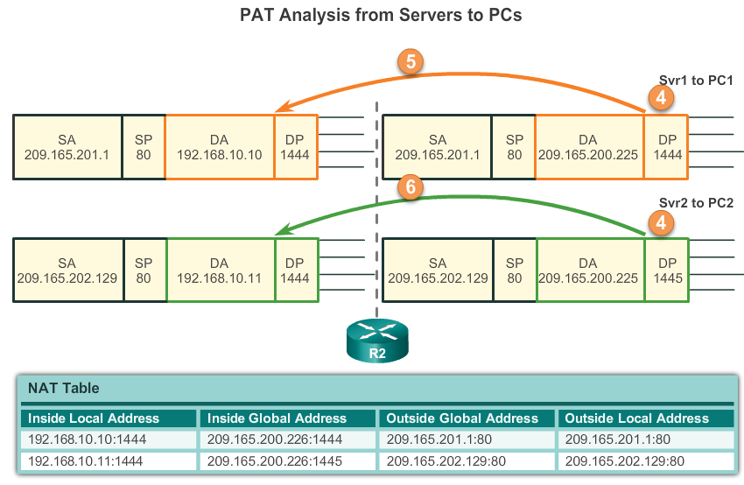
Configuring PAT Analyzing PAT
Notes:
11.2.3.3 Analyzing PAT

Slide 17
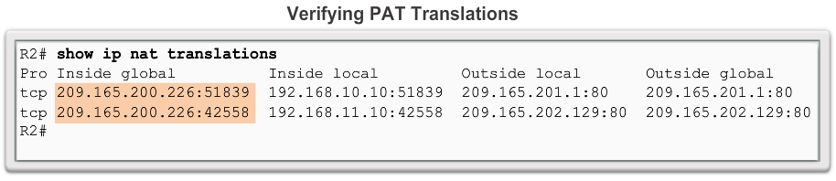
Configuring PAT Verifying PAT Translations
Notes:
11.2.3.4 Verifying PAT

Slide 18
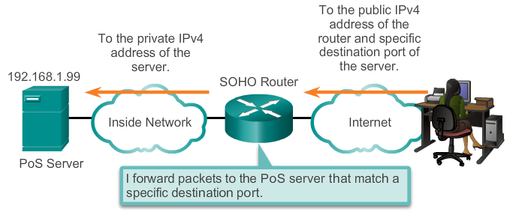
Port Forwarding Port Forwarding
Port forwarding is the act of forwarding a network port from one network node to another.
A packet sent to the public IP address and port of a router can be forwarded to a private IP address and port in inside network.
Port forwarding is helpful in situations where servers have private addresses, not reachable from the outside networks.
Notes:
11.2.4.1 Port Forwarding

Slide 19
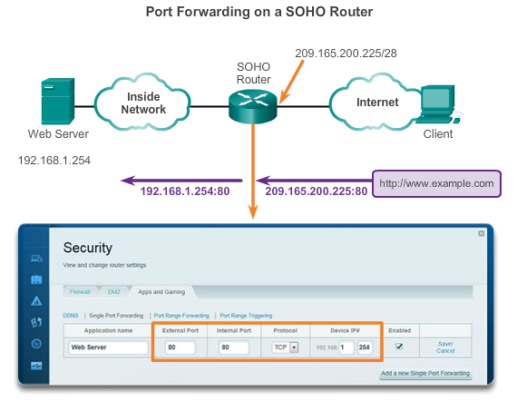
Port Forwarding SOHO Example
Notes:
11.2.4.2 SOHO Example

Slide 20
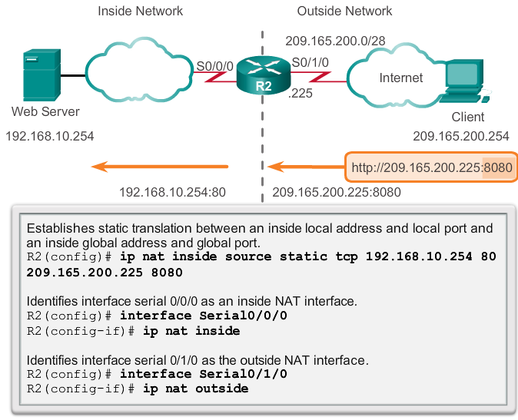
Port Forwarding Configuring Port Forwarding with IOS
In IOS, Port forwarding is essentially a static NAT translation with a specified TCP or UDP port number.
Notes:
11.2.4.3 Configuring Port Forwarding with IOS

Slide 21
Configuring NAT and IPv6 NAT for IPv6?
NAT is a workaround for IPv4 address scarcity.
IPv6 with a 128-bit address provides 340 undecillion addresses.
Address space is not an issue for IPv6.
IPv6 makes IPv4 public-private NAT unnecessary by design; however, IPv6 does implement a form of private addresses, and it is implemented differently than they are for IPv4.
Notes:
11.2.5.1 NAT for IPv6?

Slide 22
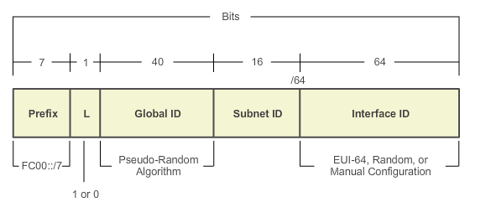
Configuring NAT and IPv6 IPv6 Unique Local Addresses
IPv6 unique local addresses (ULAs) are designed to allow IPv6 communications within a local site.
ULAs are not meant to provide additional IPv6 address space.
ULAs have the prefix FC00::/7, which results in a first hextet range of FC00 to FDFF.
ULAs are also known as local IPv6 addresses (not to be confused with IPv6 link-local addresses).
Notes:
11.2.5.2 IPv6 Unique Local Addresses

Slide 23
Configuring NAT and IPv6 NAT for IPv6
IPv6 also uses NAT, but in a much different context.
In IPv6, NAT is used to provide transparent communication between IPv6 and IPv4.
NAT64 is not intended to be a permanent solution; it is meant to be a transition mechanism.
Network Address Translation-Protocol Translation (NAT-PT) was another NAT-based transition mechanism for IPv6, but is now deprecated by IETF.
NAT64 is now recommended.
Notes:
11.2.5.3 NAT for IPv6

Slide 24
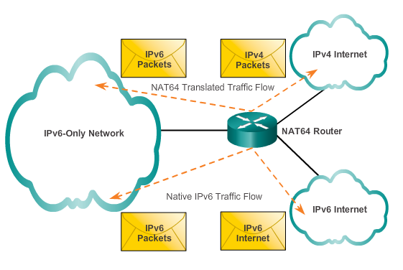
Configuring NAT and IPv6 NAT for IPv6
Notes:
11.2.5.3 NAT for IPv6

Slide 25
11.3 Troubleshooting NAT
Notes:
11.3 Troubleshooting NAT

Slide 26
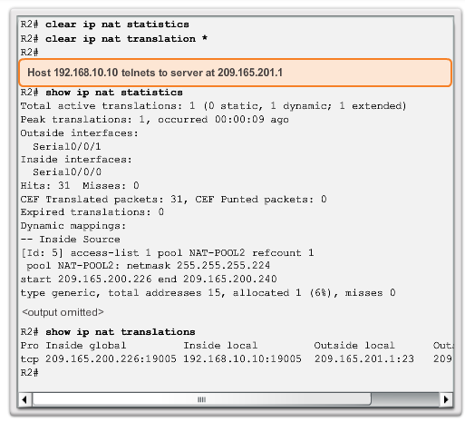
Configuring NAT and IPv6 Troubleshooting NAT: show commands
Notes:
11.3.1.1 Troubleshooting NAT: show commands

Slide 27
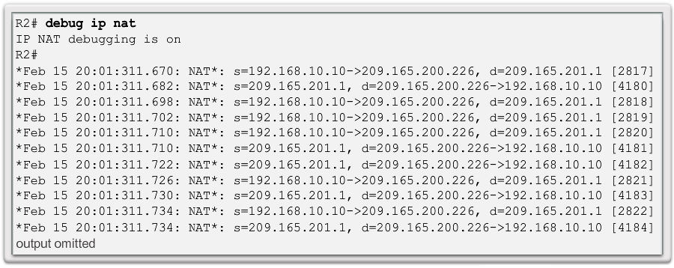
Configuring NAT and IPv6 Troubleshooting NAT: debug command
Notes:
11.3.1.2 Troubleshooting NAT: debug command

